Slide 1
Ecogame
Unfolding and rules of the game

Slide 2
Game scenario

Slide 3
Game settings and players’ objective
4 – 8 players divided in 4 groups.
Each group play the role of a village head
The game is led in 8 rounds. One round represents one year in the territory

Slide 4
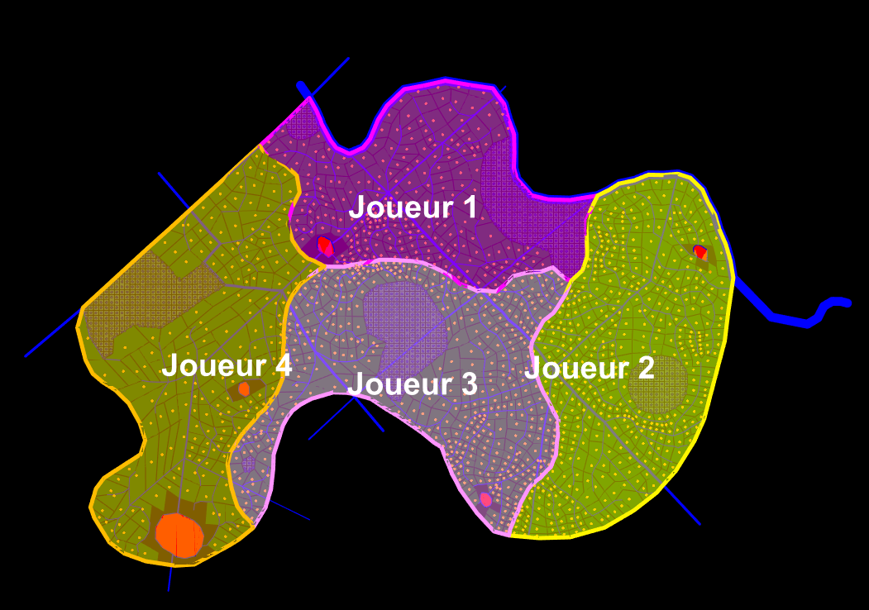
Functionning of the territory
The commune is imaginary
It is divided in 4 villages. Each village is led by one group

Slide 5
Functionning of the territory
The territory is composed by several entities
The population (inhabitants and farmers) produce two types of waste
Insert image of a local area with a caption
Insert image of waste water and solid waste

Slide 6
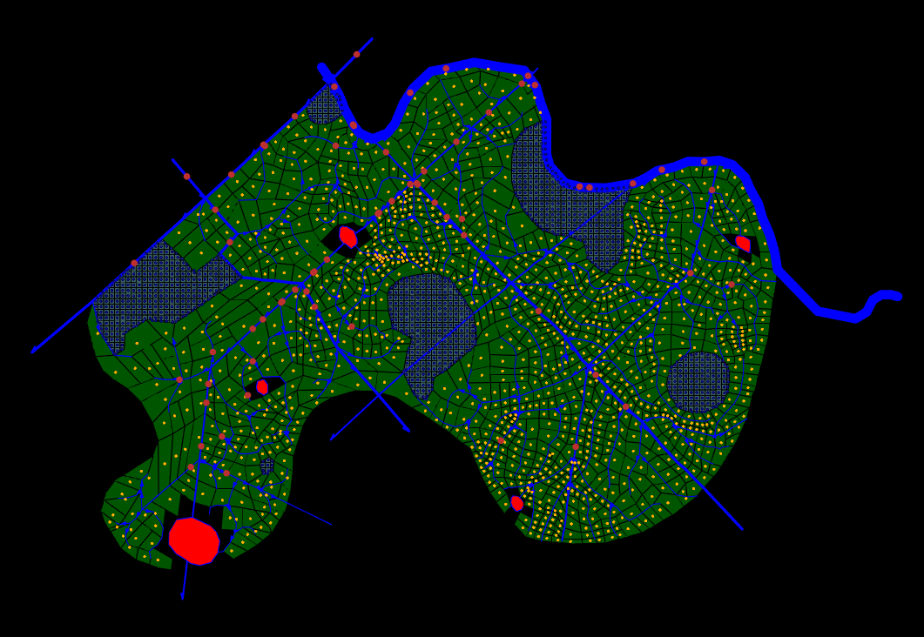
Functionning of the territory
These different types of waste are distributed differently on the territory
The canals have a specific way to make wastes travel throughout the territory (see on presentation model)
Reuse previous image with entities to explain how the waste is distributed

Slide 7
Players’ objective and actions
Players’ objective : take actions every turn to meet the EcoLabel criteria linked to pollution and production
Each player has in their posession a deck of 9 actions that have different impacts on pollution and production
Insert image of two cards

Slide 8
Players’ objective and actions
Each action have a different impact on pollution or production, sometimes both
Some actions can have different levels of impact. A lower impact also means the action is less expensive to take
The actions taken by each group have an effect on the following year, or on the long term in the game. The long terms actions are marked with a star next to the card’s title
To understand better the functionning of each action, we divided in three parts :
Mandatory actions : actions 1, 3 (when the players negociated to take it). They are taken at the begining of every turn, before any other action
Punctual actions for the next year : action 2, 4, 5, 7, 8. If taken, these actions will have an impact only for the next year
Long term actions : actions 6, 9. If taken, these actions have an impact until the end of the 8 rounds

Slide 9
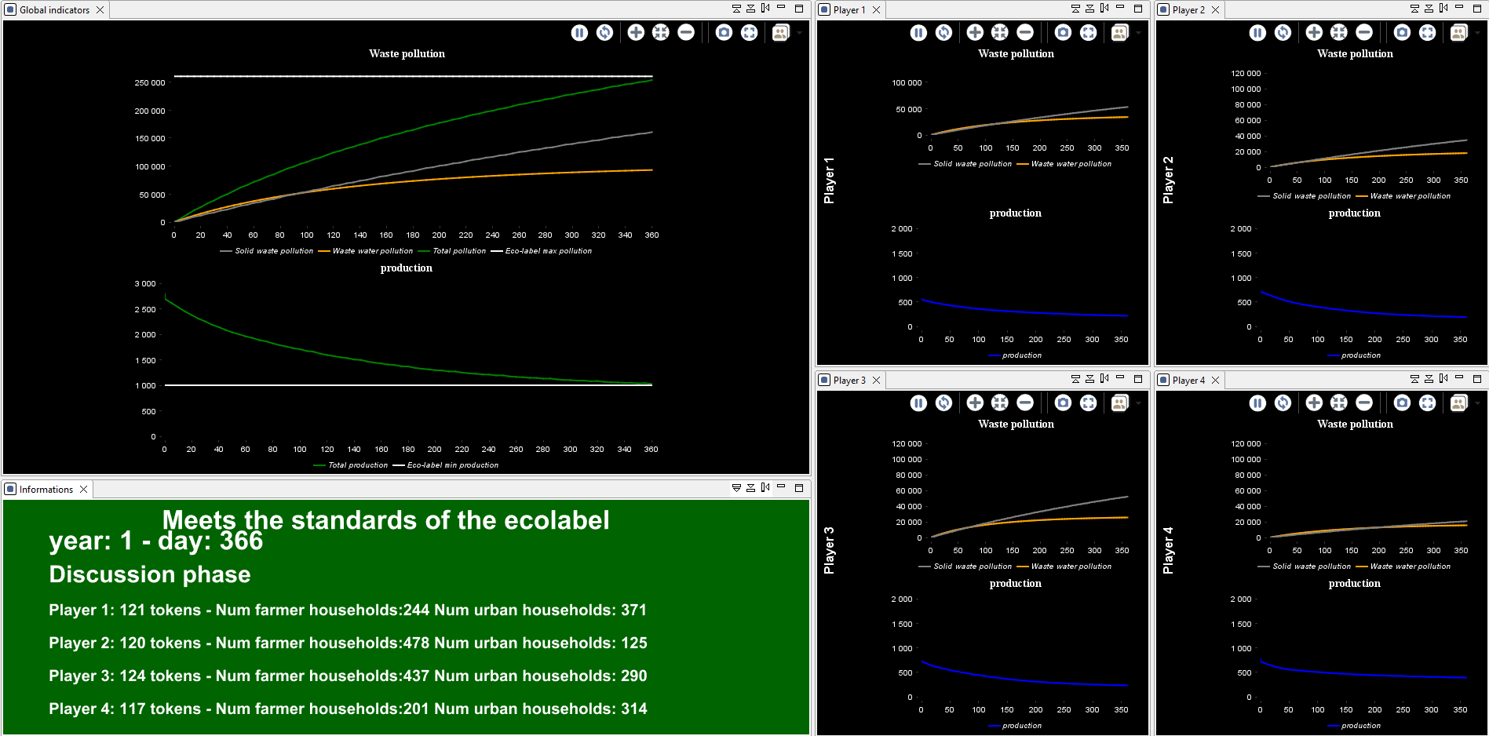
Maps and displays
The players will have several pieces of information to guide their choice
First, they will have access to the pollution and production of each village (individual indicators) and of the commune (global indicators)

Slide 10
Maps and displays
Second, the players will be able to navigate between different representation of the territory through 4 maps :
Global pollution location
Solid waste pollution
Canals pollution
Production map
Insert image of the 4 maps

